Slide 1
DANIEL

Slide 2
DANIEL
Therefore when you see the "abomination of desolation," spoken of by Daniel the prophet, standing in the holy place (whoever reads, let him understand)…
Matthew 24.15

Slide 3
DANIEL
70+ yr. Ministry
595BC
575BC
555BC
535BC
1st Deportation
(605 BC)
3rd Deportation
(585 BC)
2nd Deportation
(597 BC)
3 Hebrews in the fiery furnace
(576 BC?)
Belshazzar’s Feast
(539 BC)
Nebuchadnezzar’s Dream
(603 BC)
Daniel’s Vision of the End
(533 BC)
Nebuchadnezzar’s
Image
(576 BC?)
Timeline of 70 year captivity

Slide 4
DANIEL
Daniel “wordle”

Slide 5
DANIEL
Daniel
Hananiah
Mishael
Azariah
Belteshazzar
Shadrach
Meshach
Abed-Nego

Slide 6
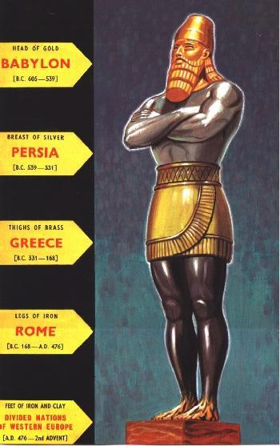
DANIEL
Head of Gold ~ Babylon (605-539 BC)
Breast of Silver ~ Persia (539-331BC)
Thighs of Brass ~ Greece (331-168 BC)
Legs of Iron ~ Rome (168 BC-AD 476
Feet of Iron and Clay ~ Revived Roman Empire
The Metallic Image

Slide 7
DANIEL
Shadrach, Meshach and Abed-Nego
~ Israel
Daniel
~ Church

Slide 8
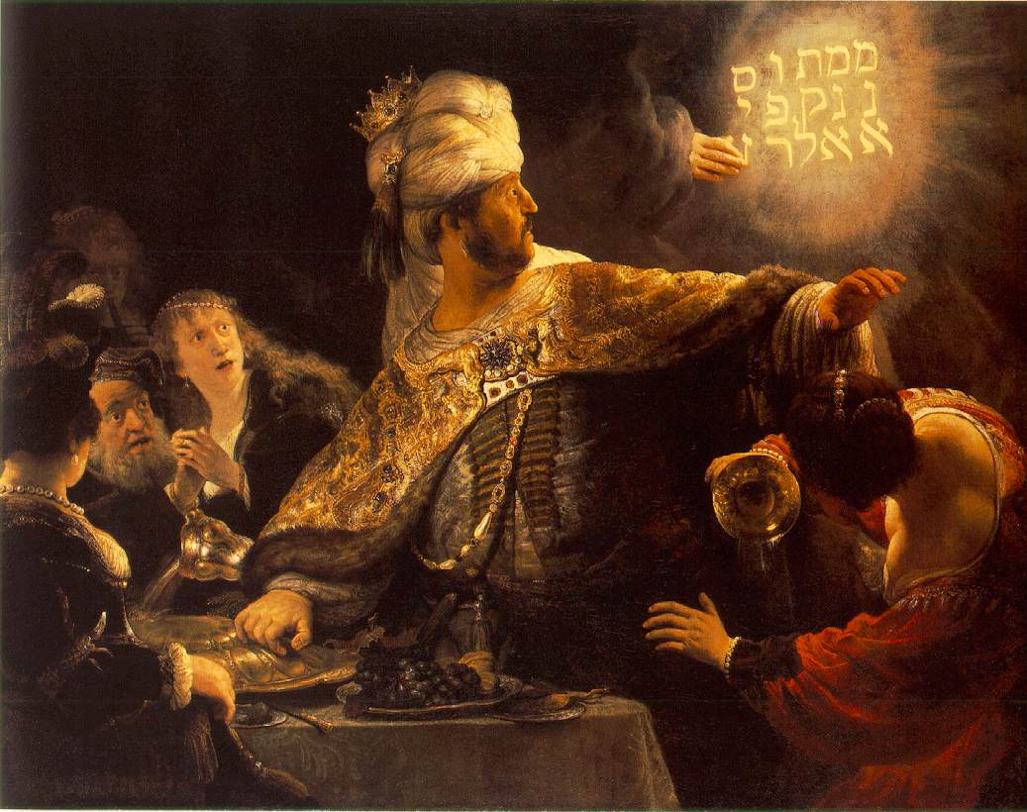
DANIEL
The Handwriting on the Wall

Slide 9
DANIEL
Most men will proclaim each his own goodness,
But who can find a faithful man?
Proverbs 20.6

Slide 10
DANIEL
Lion ~ Babylon (605 - 539 BC)
Bear ~ Medo-Persian (539 - 331 BC)
Leopard ~ Greek (331 - 168 BC)
Dreadful Beast ~ Roman Empire (168 BC - AD 476)
Vision of the Four Beasts

Slide 11
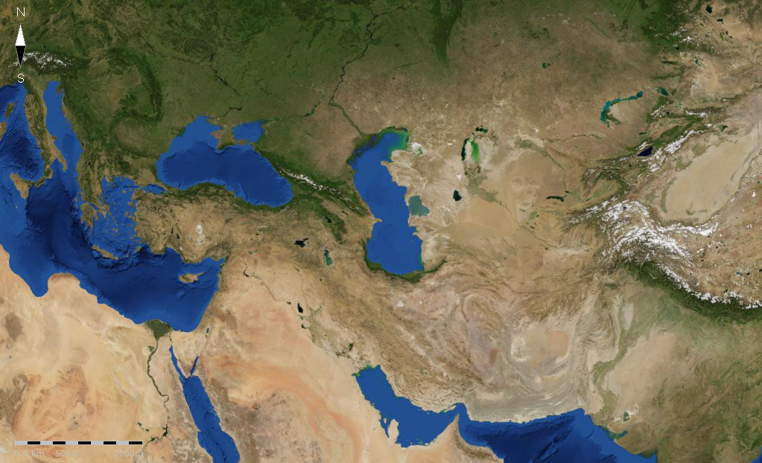
DANIEL
Cassander
Lysimachus
Seleucus
Ptolemy
Division of Alexander’s Empire

Slide 12
DANIEL
173,880 days
Church Age
Jerusalem rebuilt
Triumphal Entry Mar. 30, AD 33
Rapture of the Church
Artaxerxes' decree Mar. 5, 444 BC
7 weeks (49yr)
62 weeks (424 yr)
1 week (7 yr)
Daniel’s 70 Weeks

Slide 13
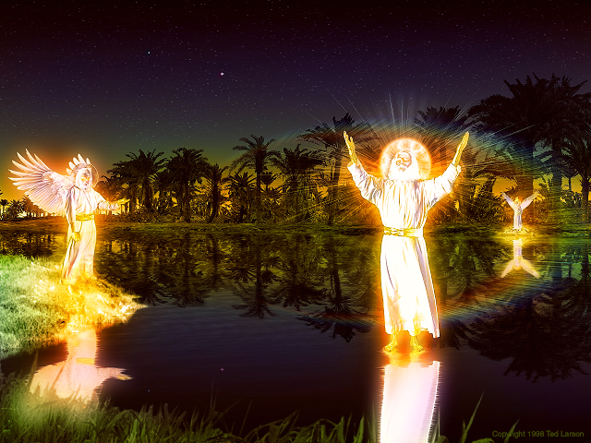
DANIEL

